Slide 1

Department Of Computer Science, CUI Lahore Campus
CSC102 - Discrete Structures
By
Mahwish Waqas

Slide 2
Lecture Outline
Recursion
Recursive definition of function
Recursive definition of sequence
Recursive definition of sets

Slide 3
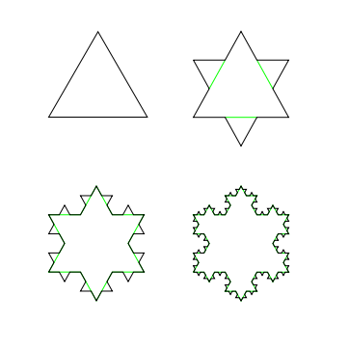
Recursive Objects
Recursion is the process of repeating items in a self-similar way.
Sometimes it is difficult to define an object explicitly, but it is easier to define it in terms of itself.

Slide 4
Factorial Recursive Function
int factorial(int n)
{
if(n == 0)
return 1;
else
return n * factorial(n - 1);
}
Basis Step
Recursive Step

Slide 5
Recursive Functions
We can define a function recursively by specifying:
Basis: the value of the function at the smallest element of the domain.
e.g. : f(0) = 1
Recursive step: A rule for finding the value of the function at an integer from its values at smaller integers.
e.g. : f(n+1) = 2 * f(n)
Many common functions can be defined recursively.

Slide 6
Example
Can you write n! as a recursive function
F(0) = 1
F(n) = n * F(n-1)
What is the value of F(5)?
F(5) = 5F(4)
= 5 . 4F(3)
= 5 . 4 . 3F(2)
= 5 . 4 . 3 . 2F(1)
= 5 . 4 . 3 . 2 . 1F(0)
= 5 . 4 . 3 . 2 . 1 . 1 = 120

Slide 7
Example
Can you write n! as a recursive function
F(0) = 1
F(n) = n * F(n-1)
What is the value of F(5)?

Slide 8
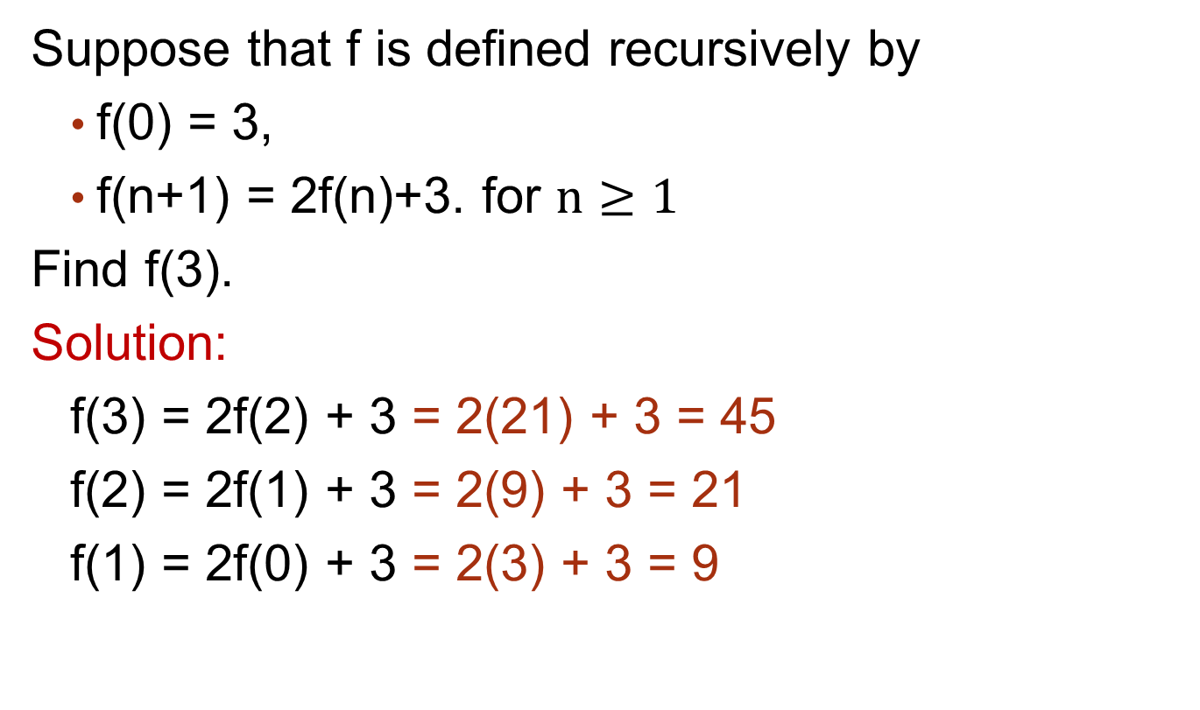
Example
Suppose that f is defined recursively by
f(0) = 3,
f(n+1) = 2f(n)+3. for $n≥1$
Find f(3).
Solution:
f(3) = 2f(2) + 3 = 2(21) + 3 = 45
f(2) = 2f(1) + 3 = 2(9) + 3 = 21
f(1) = 2f(0) + 3 = 2(3) + 3 = 9

Slide 9
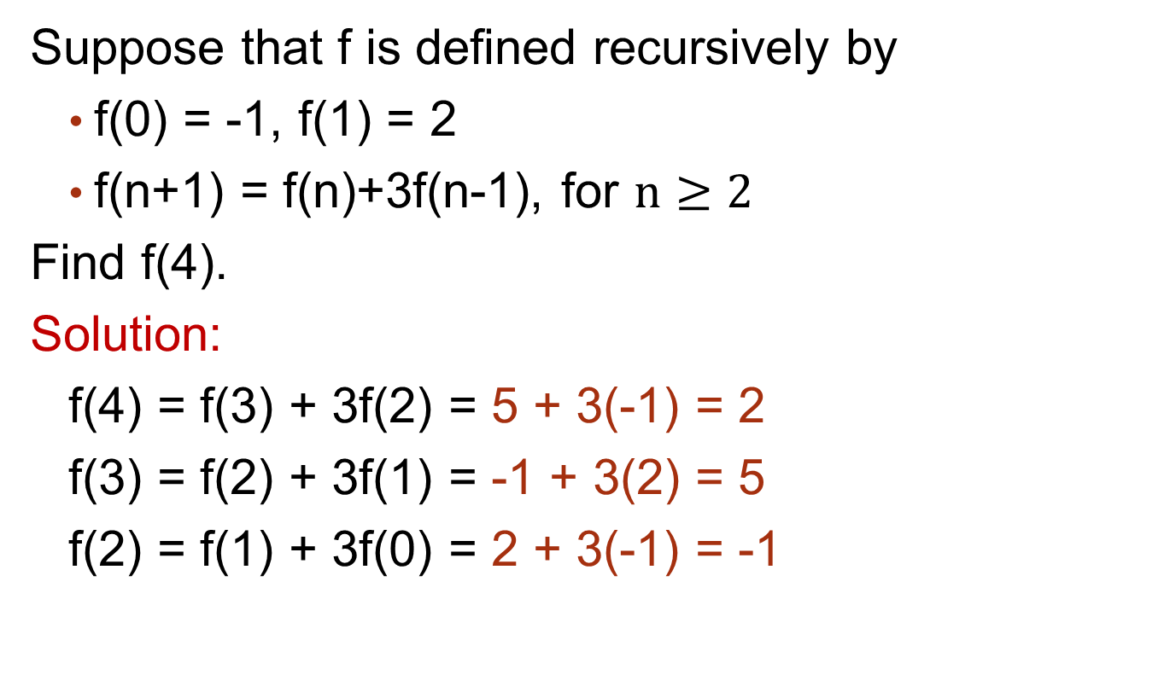
Example
Suppose that f is defined recursively by
f(0) = -1, f(1) = 2
f(n+1) = f(n)+3f(n-1), for $n≥2$
Find f(4).
Solution:
f(4) = f(3) + 3f(2) = 5 + 3(-1) = 2
f(3) = f(2) + 3f(1) = -1 + 3(2) = 5
f(2) = f(1) + 3f(0) = 2 + 3(-1) = -1

Slide 10
Example
Fibonacci Numbers
F(0) = 0, F(1) = 1
F(n) = F(n-1) + F(n-2) for n = 2, 3, 4,……
Find the Fibonacci number F(4).
Solution:
F(4) = F(3) + F(2) = 2 + 1 = 3
F(3) = F(2) + F(1) =1 + 1 = 2
F(2) = F(1) + F(0) = 1 + 0 = 1

Slide 11
Example
Let a and b denote positive integers. Suppose a function Q is defined recursively as follows:
Find the value of Q(4,5) and Q(14,3).
Find Q(55, 7).

Slide 12
Example

Slide 13
Recursive Algorithms
An algorithm is called recursive if it solves a problem by reducing it to a smaller instance of the same problem.
Computing n!
int factorial(int n)
{ If (n==0; return 1;
else return n*factorial(n-1); }
Computing GCD
gcd(a,b)
/* assumption a < b */
If a=0, then return b
Else return gcd(b mod a, a)

Slide 14
Example

Slide 15
Sequence
Find the explicit formula and recursive formula of following sequence:
2,4,8,16,32,…
Explicit Formula: Recursive Formula:
After giving the first term, each term of the sequence can be defined from the previous term.

Slide 16
Sequence
Find the explicit formula and recursive formula of following sequence:
5,10,15,20,25,…
Explicit Formula: Recursive Formula:
After giving the first term, each term of the sequence can be defined from the previous term.

Slide 17
Recursively Defined Sets
Assume S is a set.
We use two steps to define the elements of S.
Basis step:
Specify an initial collection of elements.
Recursive step:
Give a rule for forming new elements from those already known to be in S.

Slide 18
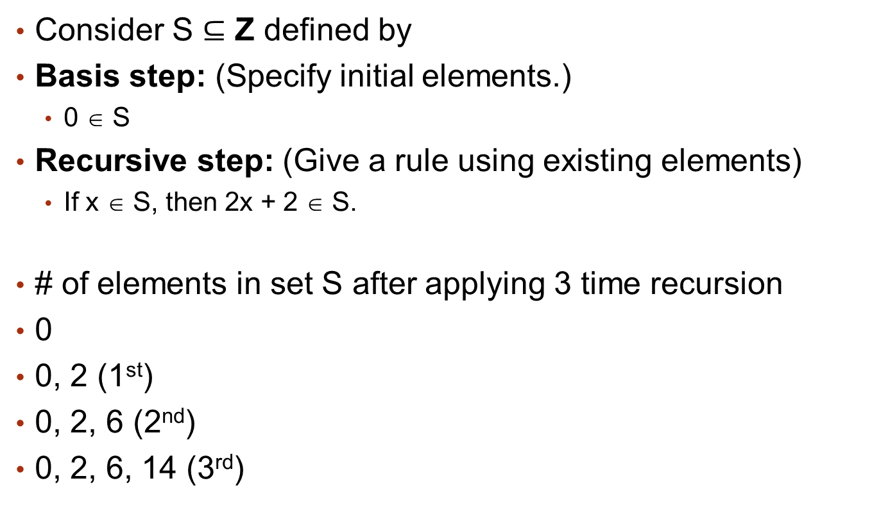
Recursively Defined Sets
Consider S $⊆$ Z defined by
Basis step: (Specify initial elements.)
0 ∈ S
Recursive step: (Give a rule using existing elements)
If x ∈ S, then 2x + 2 ∈ S.
# of elements in set S after applying 3 time recursion
0
0, 2 (1st)
0, 2, 6 (2nd)
0, 2, 6, 14 (3rd)

Slide 19
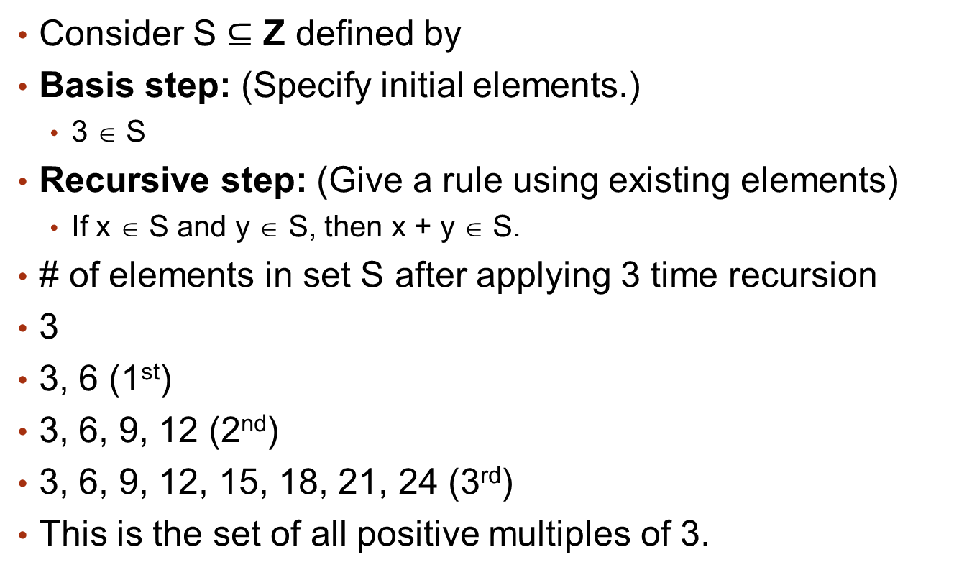
Recursively Defined Sets
Consider S $⊆$ Z defined by
Basis step: (Specify initial elements.)
3 ∈ S
Recursive step: (Give a rule using existing elements)
If x ∈ S and y ∈ S, then x + y ∈ S.
# of elements in set S after applying 3 time recursion
3
3, 6 (1st)
3, 6, 9, 12 (2nd)
3, 6, 9, 12, 15, 18, 21, 24 (3rd)
This is the set of all positive multiples of 3.

Slide 20
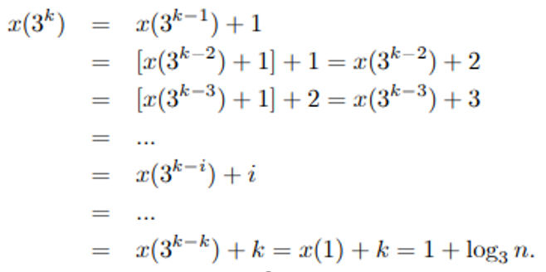
Example: (Solving recurrence relation

Slide 21
Exercise Questions
Chapter # 5
Topic # 5.3
Q. 1, 2, 3, 4, 7, 27-a, 48 (Ackermann’s Function), 51

